Slide 1


BUILD AN ADAPTIVE AI TUTOR WITH GRADIO INTERFACE FOR MULTI-LEVEL LEARNING

Slide 2


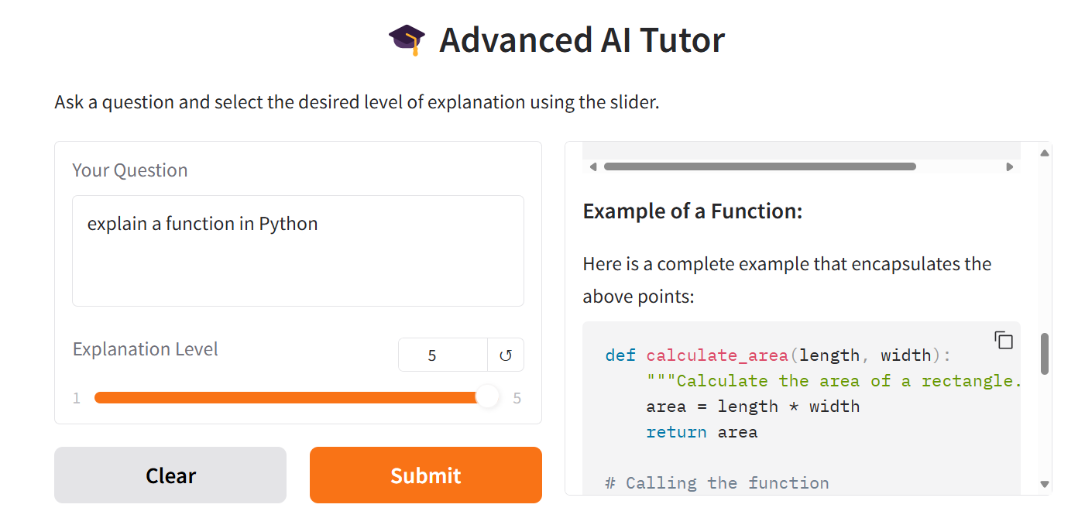
Project Overview
In this project, we’ll build an AI Tutor to deliver multi-level explanations. A key feature will be a complexity slider, allowing users to adjust the explanation level – from “Explain like I’m 5” to expert-level.
We’ll also design a user-friendly web interface using Gradio, a powerful library for building interactive applications. Finally, we’ll implement streaming responses to enhance the user experience by displaying answers in real time.
Model Output
Okay! Imagine you have a magic box. When you put something special into the box, like a toy or a piece of candy, and close it, the box does something cool and gives you back something different!
In Python, a function is like that magic box. You can tell it to do something with the stuff you give it (we call that stuff "input"), and then it gives you back something else (that's called "output").
Model Input
Explain a Python Function
OpenAI API
© All rights reserved for Dr. Ryan Ahmed @Stemplicity Inc.
Explanation Level
5-Year-old

Slide 3

Key Learning Outcomes
Master “Gradio” to create powerful web interface for our AI Tutor.
Implement streaming responses in the Gradio app for a better user experience.
Build an AI Tutor that can adjust its level by adding a slider to control the complexity of the explanation (from explaining to a 5-year-old to an expert).
© All rights reserved for Dr. Ryan Ahmed @Stemplicity Inc.

Slide 4

What is Gradio?
Gradio is the fastest way to demo your machine learning model with a friendly web interface so that anyone can use it, anywhere!
Easy Setup & Integration: Install with pip and create interfaces in just a few lines—works with any Python function or library.
Instant Sharing: Embed in notebooks or launch as a web app with a shareable public link for remote access.
Permanent Hosting: Deploy on Hugging Face Spaces for long-term access and a dedicated URL.
© All rights reserved for Dr. Ryan Ahmed @Stemplicity Inc.

Slide 5

Summary
Gradio makes it easy to build and deploy powerful user interfaces with just a few lines of code.
Enabling streaming responses adds a human-like, real-time chat experience with LLMs.
With Gradio, you can quickly create interactive AI apps using various UI components like text boxes, sliders, maps, and more.
© All rights reserved for Dr. Ryan Ahmed @Stemplicity Inc.

Slide 6
Thank you!

